Slide 1
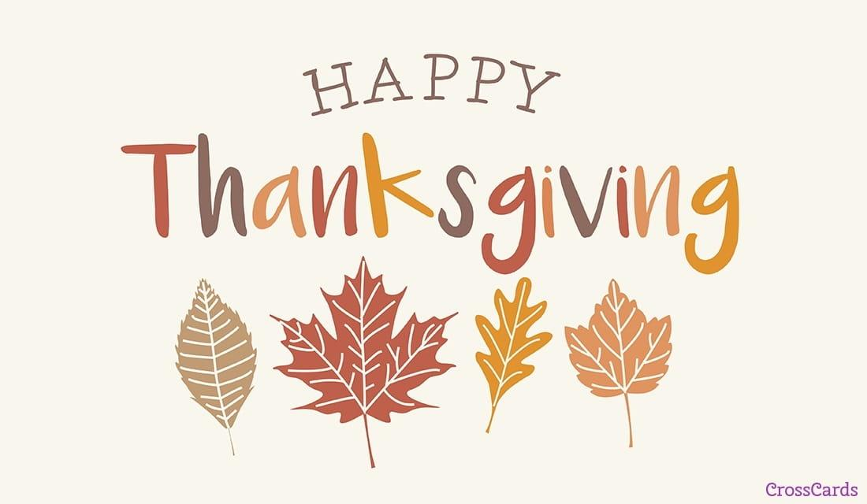

Slide 2
Thanksgiving History
Thanksgiving began in 1621 and it was celebrated by the Pilgrims and the Native Americans.
The first year of life for the Pilgrims was very difficult, but the Native Americans helped them out.
The next year, they had lots of crops and food.
They wanted to celebrate and had a big feast in November.

Slide 3
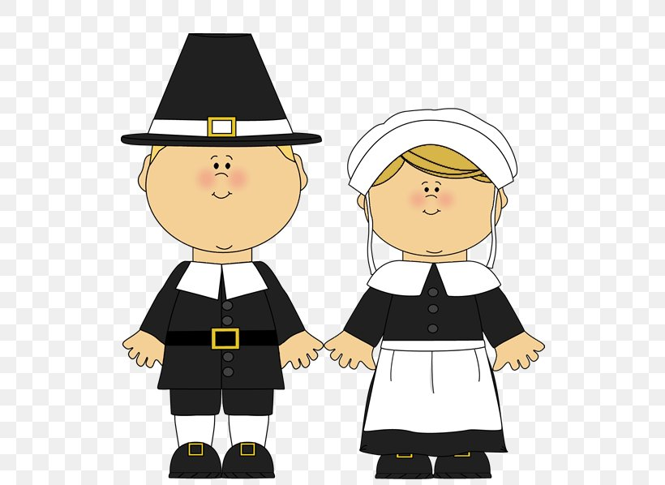
Who were the Pilgrims?
The Pilgrims were the first people from England to come to America.
They went on a ship called “The Mayflower” and arrived in America in 1620.
They left England so they could practice their religion freely.

Slide 4
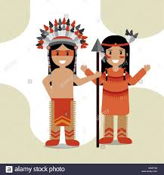
Who were the Native Americans?
The Native Americans were the people who lived in America before the Pilgrims arrived.
They had thousands of years of tradition and learned how to live off of the land.
Thanksgiving is a day of spiritual remembrance and cultural heritage to Native American tribes.

Slide 5
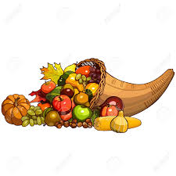
Celebrated on the 4th Thursday in November
Big family reunion and dinner
Dinner usually happens around 2 o’clock
What is Thanksgiving?

Slide 6
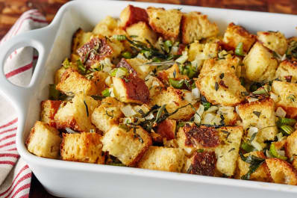
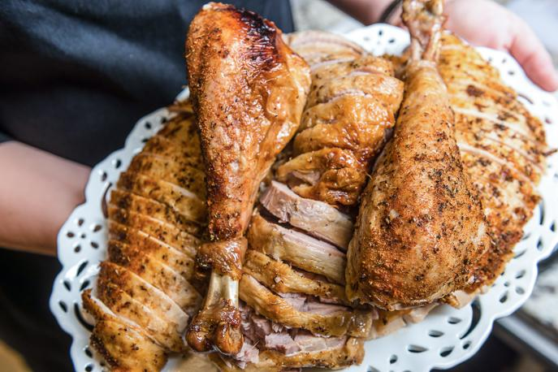
Thanksgiving Dinner
Turkey
Stuffing

Slide 7
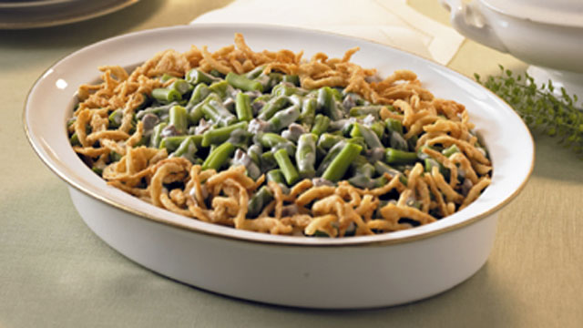
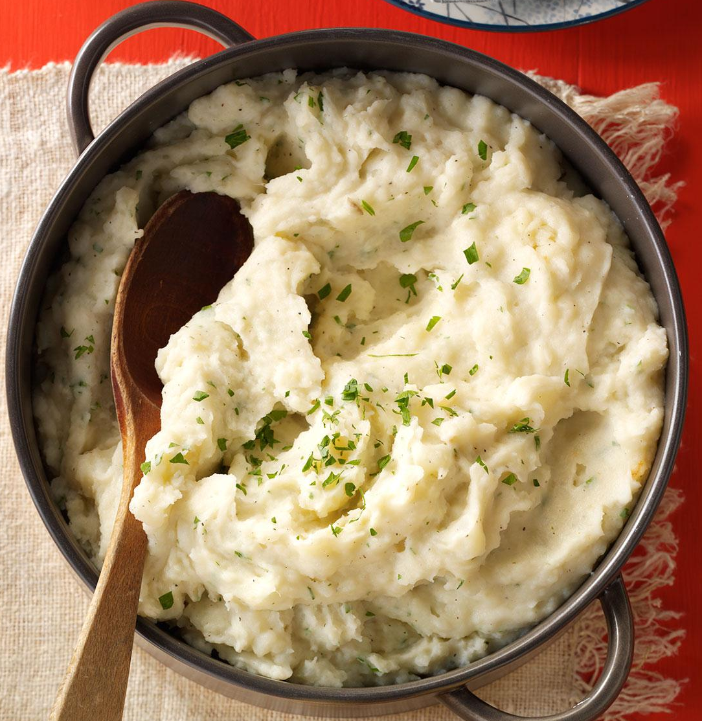
Mashed potatoes
Green bean casserole

Slide 8
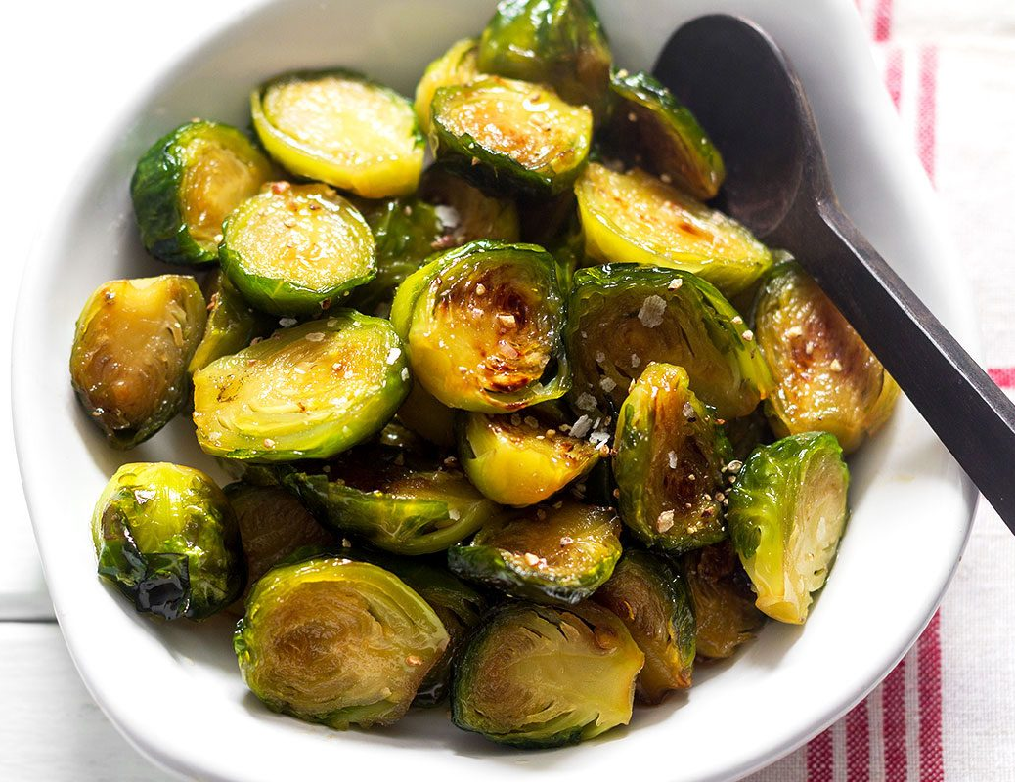
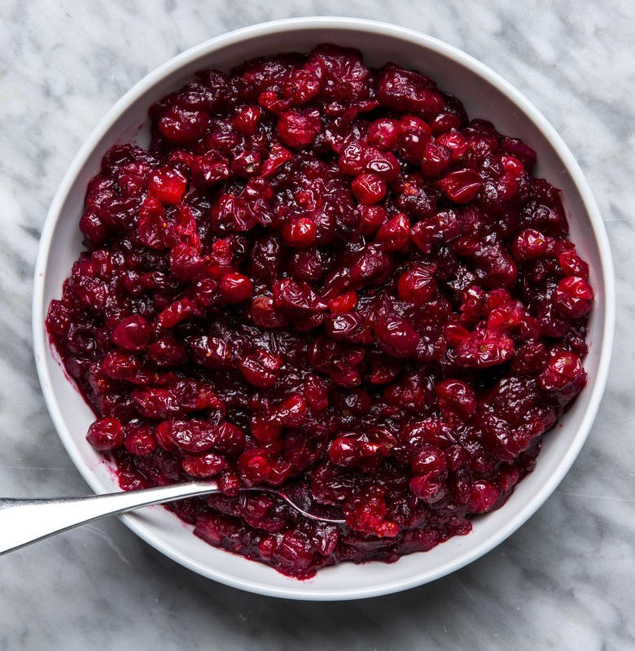
Cranberries
Brussel sprouts

Slide 9
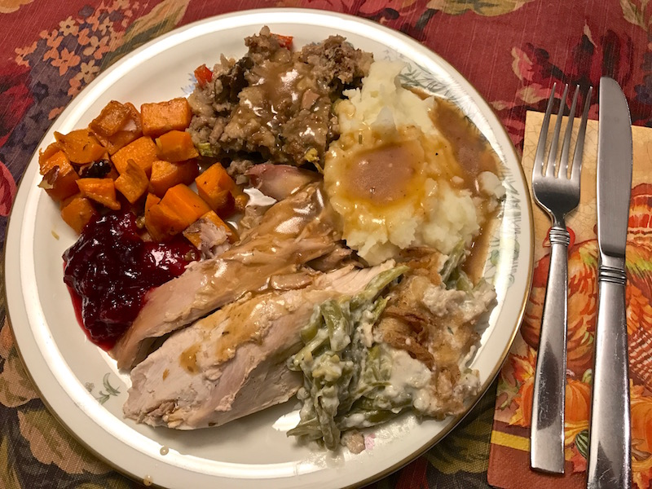
Time to eat! What´s on your thanksgiving plate?

Slide 10
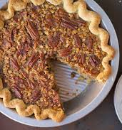
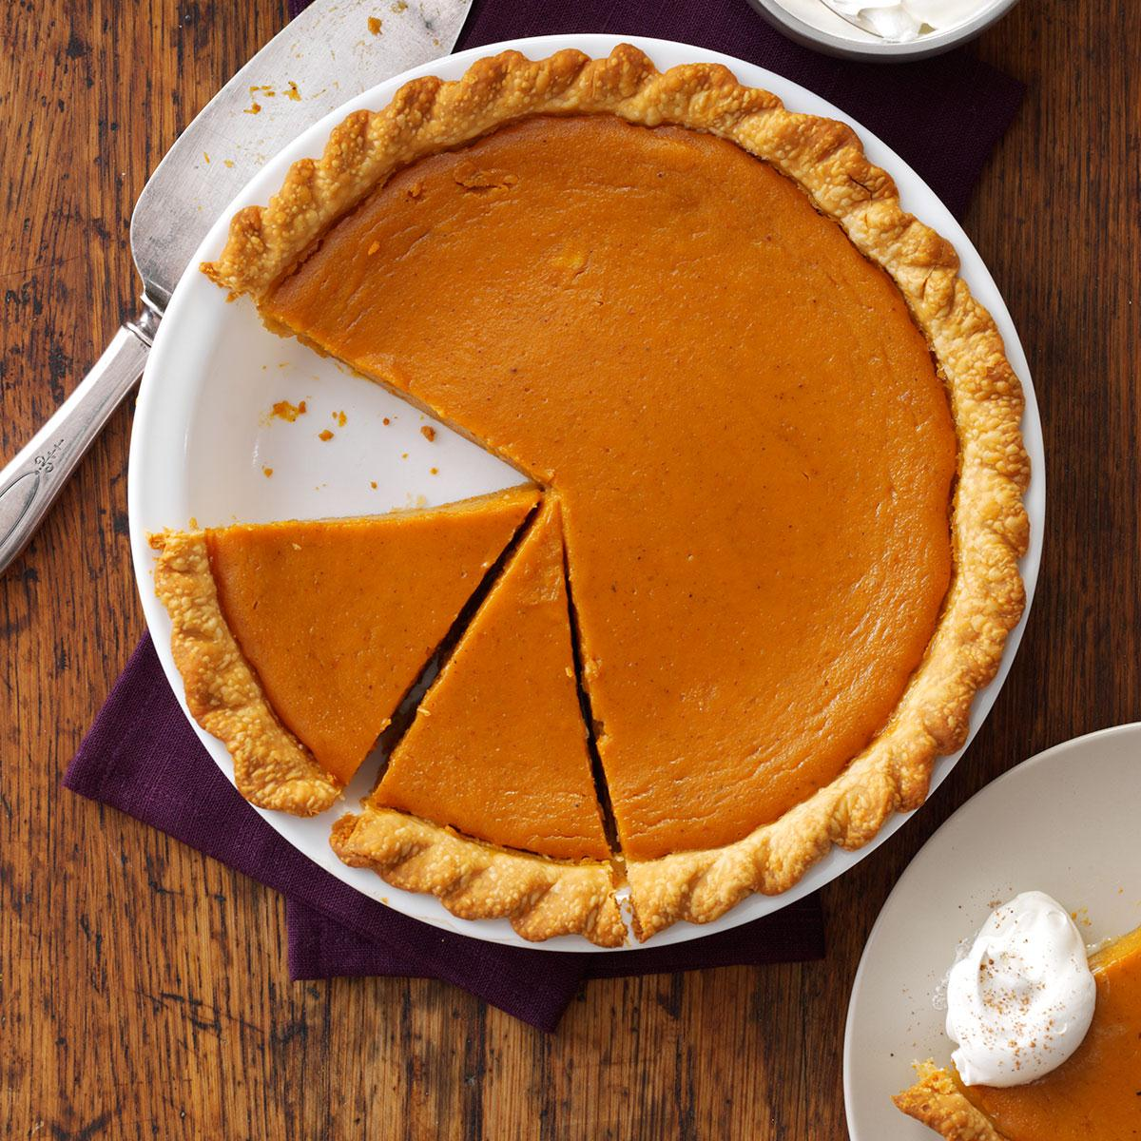
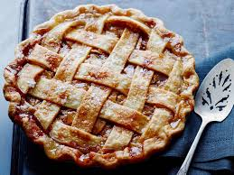
For dessert, we eat …

Slide 11

What are you thankful for?
This year, I am thankful for….
  My friends
  My family
  My pets
  My health
  My school

Slide 12
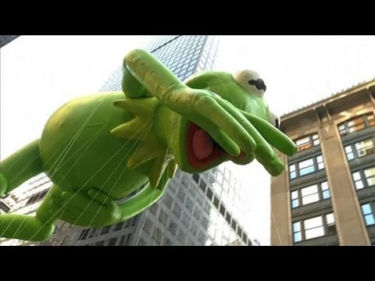
In the morning, we watch the Macy´s Day Thanksgiving parade.

Slide 13
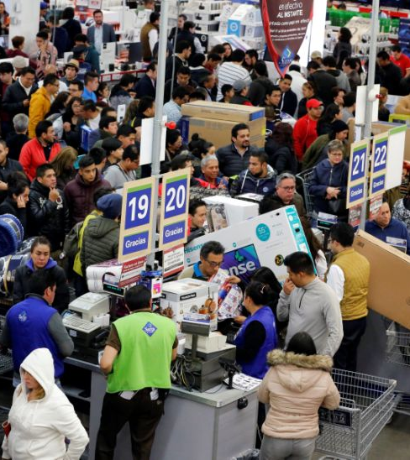
Black Friday
The day after Thanksgiving is called “Black Friday”.
This is the biggest shopping day of the year.
Stores will sell their things at a major discount.
This is when many people buy Christmas presents!

Slide 14


Cyber Monday
Cyber Monday is the Monday after Thanksgiving.
It’s where online stores (like Amazon) have really good prices.
You can buy things online for very cheap.

Slide 15
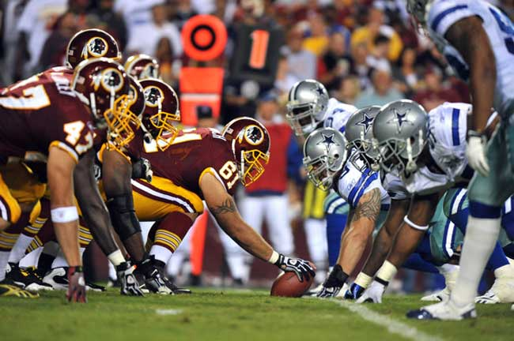
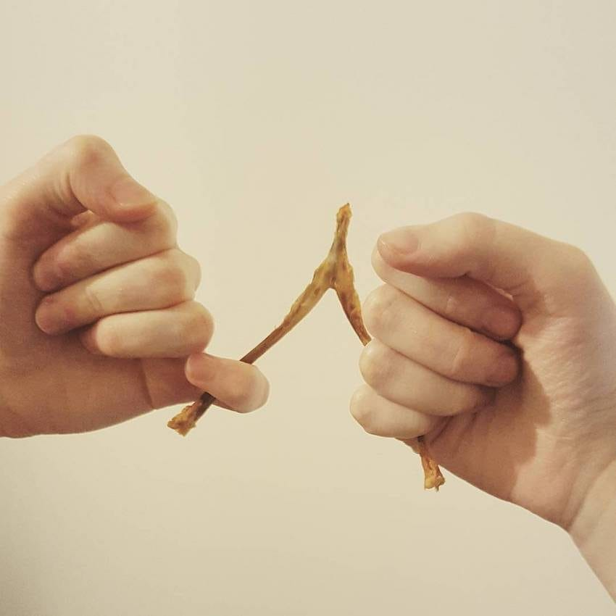
Thanksgiving traditions

