Slide 1

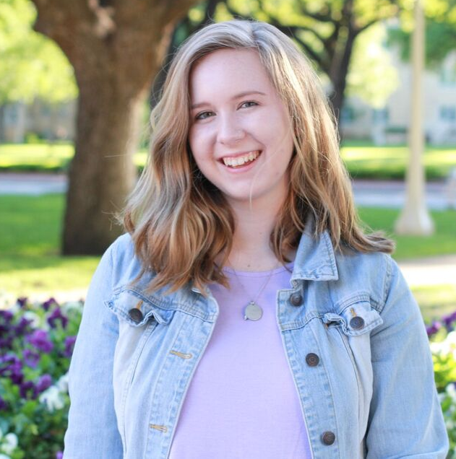

ABBY KINGSLEY
1997 - NOW

Slide 2


About Me!
HEIGHT: 5 FEET 5 INCHES OR 167.64 CM
AGE: 22 YEARS OLD
BIRTHDAY: AUGUST 19, 1997
EYE COLOR: GREEN

Slide 3
Country: USA
State: Georgia
City: Atlanta
Where I'm
from...

Slide 4
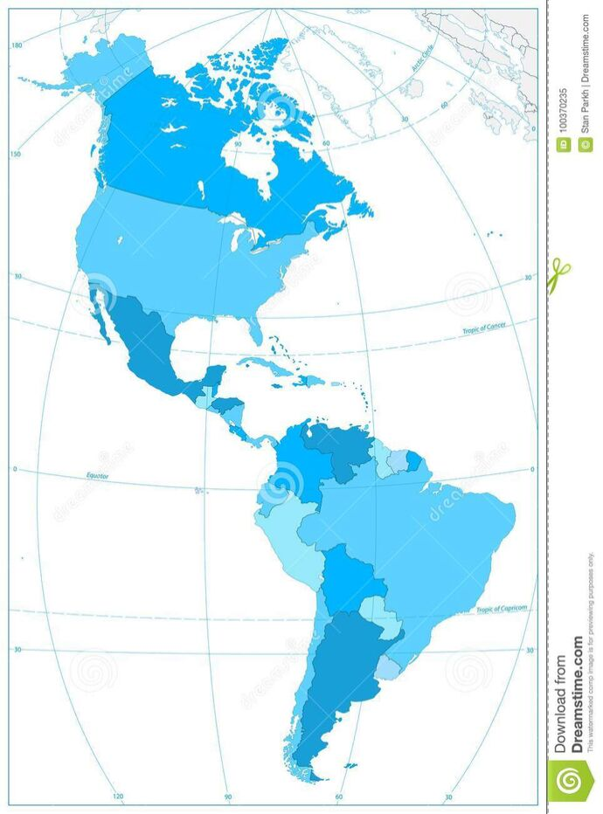

Where is the
United States?

Slide 5
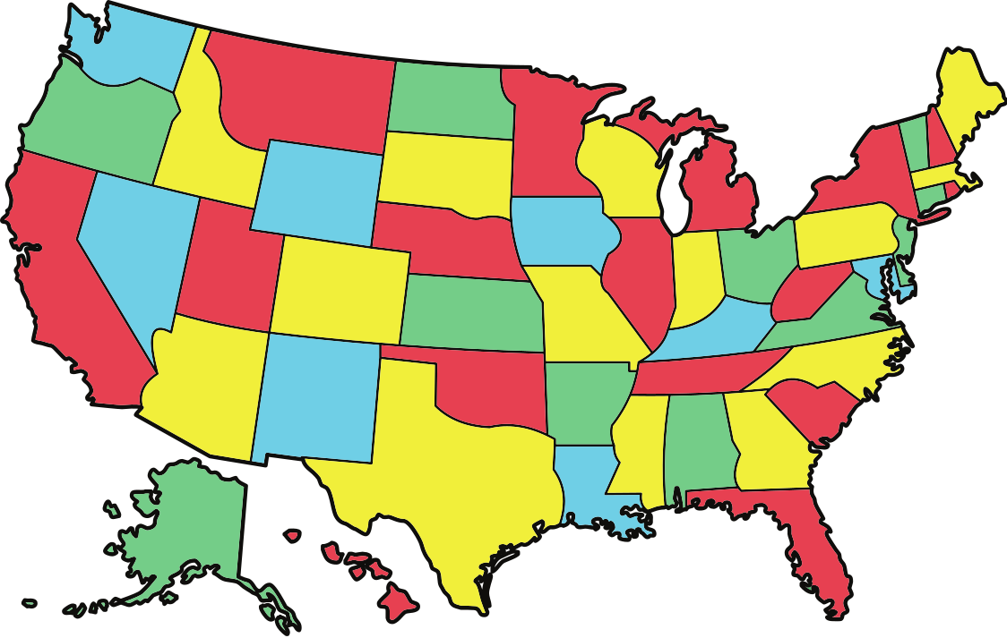
Where is Georgia?

Slide 6
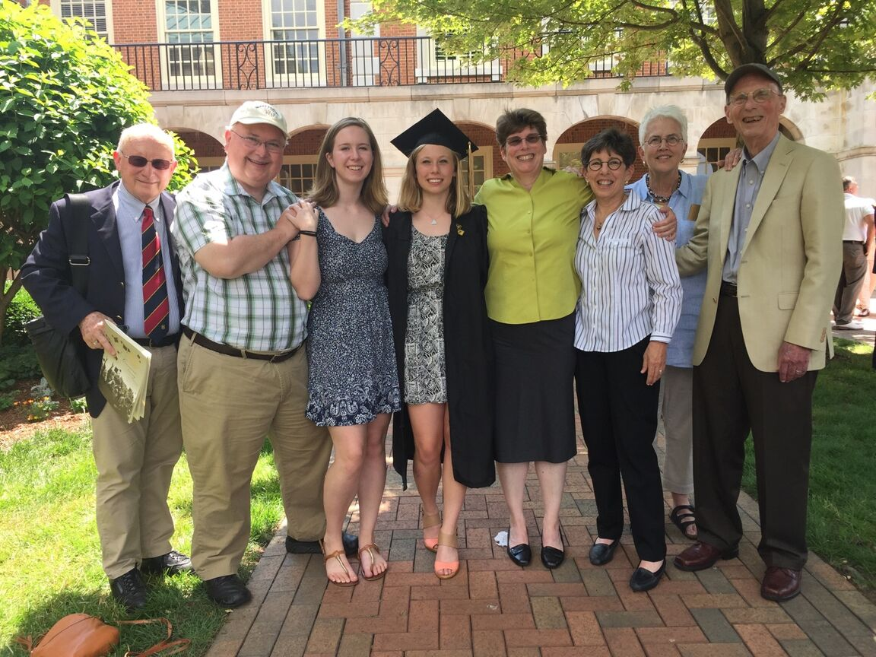
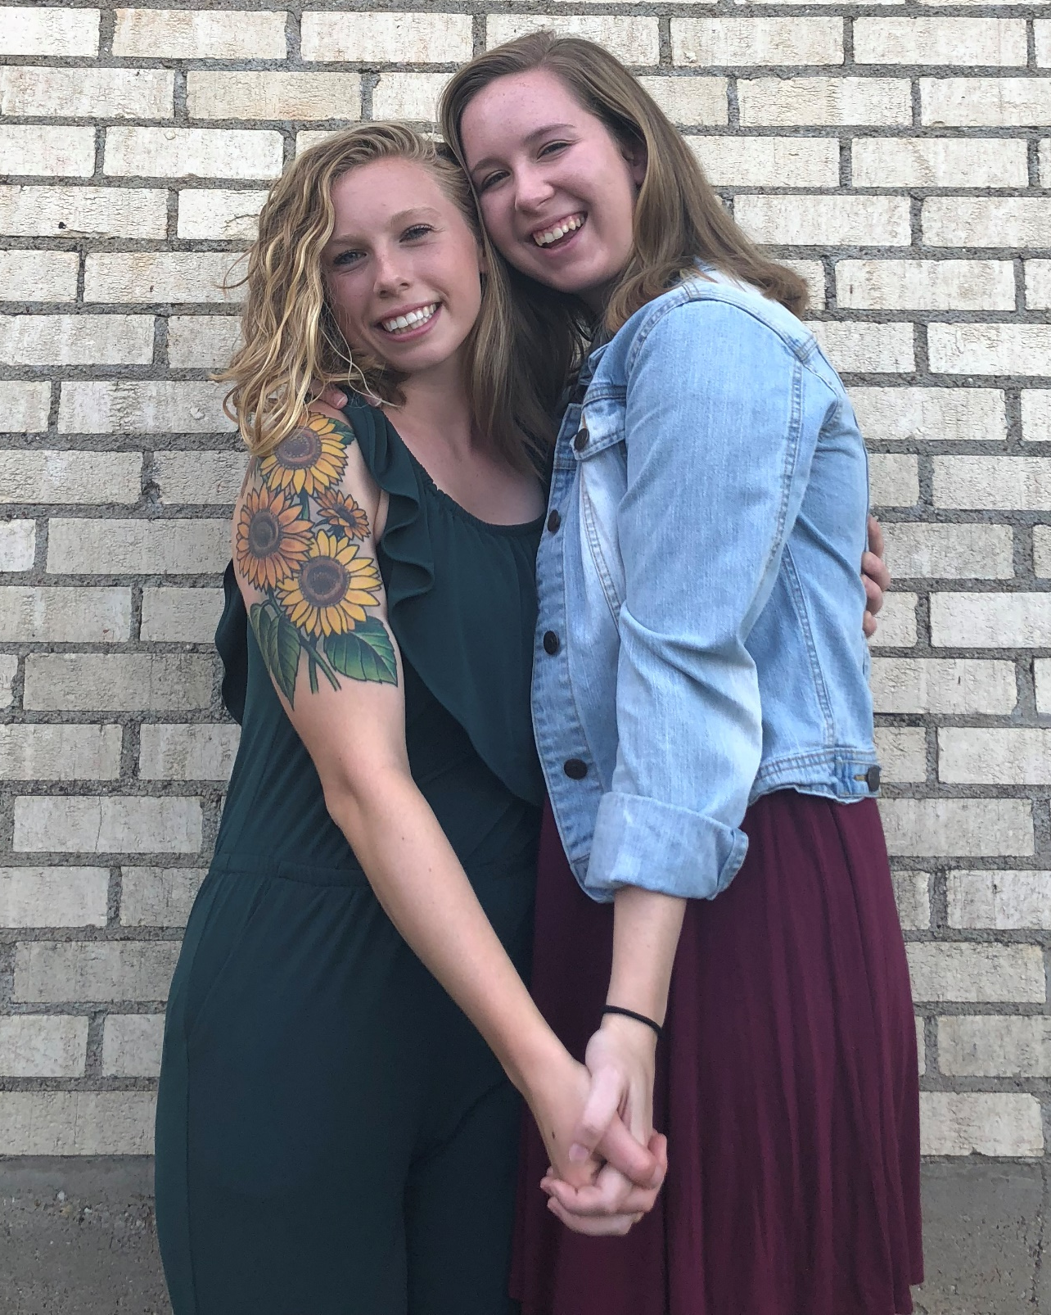
My Family

Slide 7
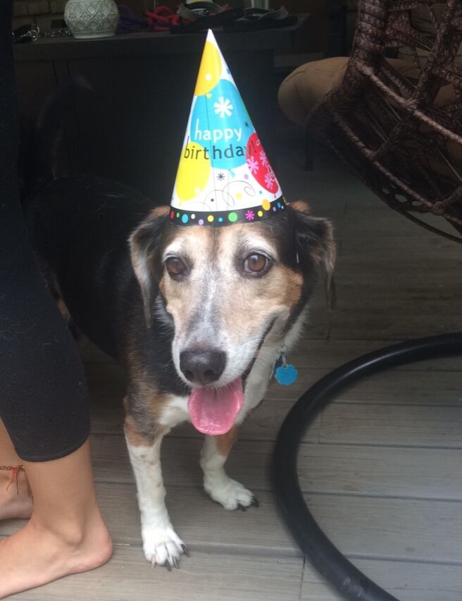
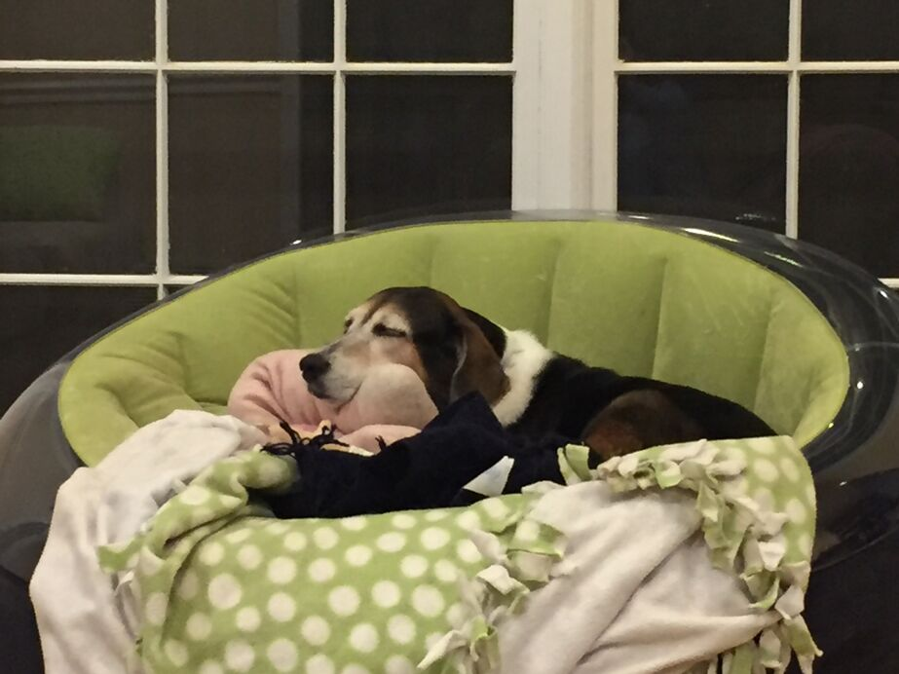
ANGELINA

Slide 8
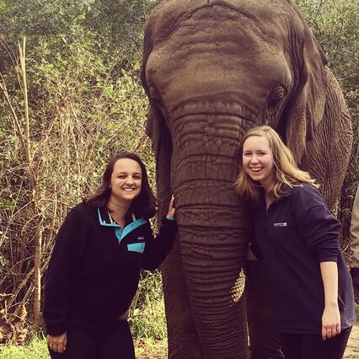

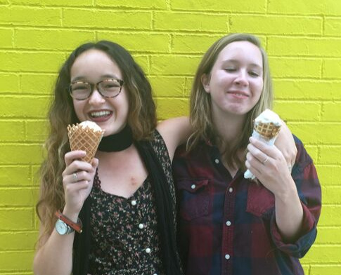
My Favorite Things
ICE CREAM
TRAVELING
HARRY POTTER

Slide 9
Thank you!

